Slide 1
The potatoes
Created by. Montella Giovanni and oliviero fabio

Slide 2
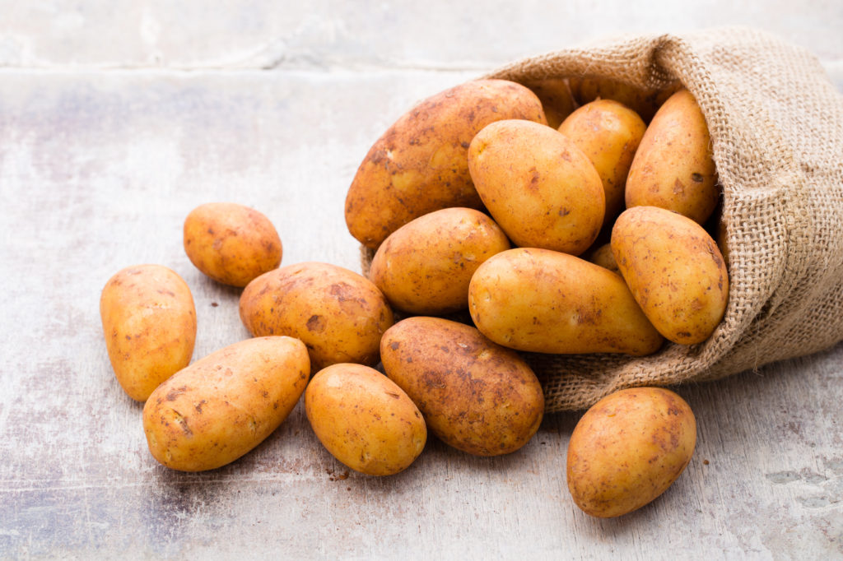
The history
The potato is an edible tuber obtained from the plants of the Solanum Tuberosum species, very used for food purpose after cooking. Maybe the Romans would appreciate the flavor of these foods or chocolate drinks, chili and other spices used in Central America. Because what we know is sure is Romani who were the spicy cuisine and agri-soluble. And yes, because the Romans in the place of the bread ate the puls, a kind of breaker of a barley flour and spelled. There are numerous recipes transcribed by the Romans. The most famous collection is the de coquinaria of the Gistronomo Apicio (lived in the sec. D.C. In the Augusteo period) or the literary description of the Trimalcion dinner, written in the Petronio Satyricon. In these cases these are recipes for the most refined and facing palates, they are certainly not the daily meals of the poor.

Slide 3
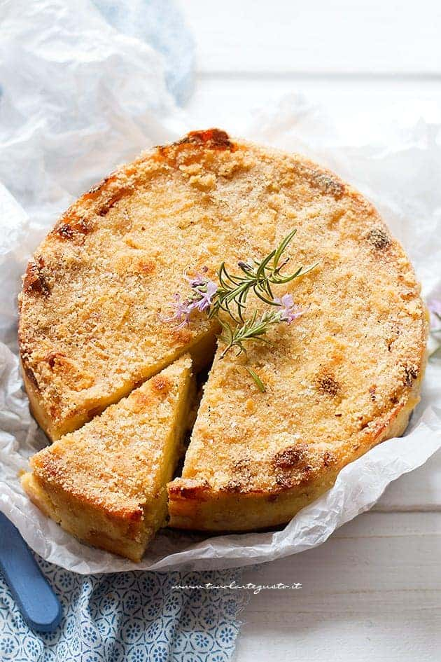
Gateau
As with the potato we can associate it with the potato gatteau. The potato gateau is a delicious preparation based on potatoes and various salami. A mess of to be strive with an ansisable golden crosticin that will ensure you succulent meal. It is a casualded of the Parthenopean cuisine and revisited then in other regions of South Italy. However, the gateau of potatoes, Italianized in Gattò or Gatò, made his appearance on the luxurious boards of the Kingdom of the two Sicily only at the end of 1700. In the Salopa's palace of the Regina Maria Carolina d'Asburg, wife of Ferdinando I Borbone, not wanted to separate from the Mannecatti of the Monsieurs - the French chefs - called upon the Court of Kind of Naples. It was so that the Napoletan people learned the technique and made his own. He replaced the Groviara with the blower of the milk, and then he could notice the paste with cooked ham and salami. And not only. Also the name soon passed from gateau of potatoes in Gattò ... and even the Monsieurs did not score to the partnership fantasy, becoming the "Monzo"! Every family handed his own version of this irresistible mess.

Slide 4
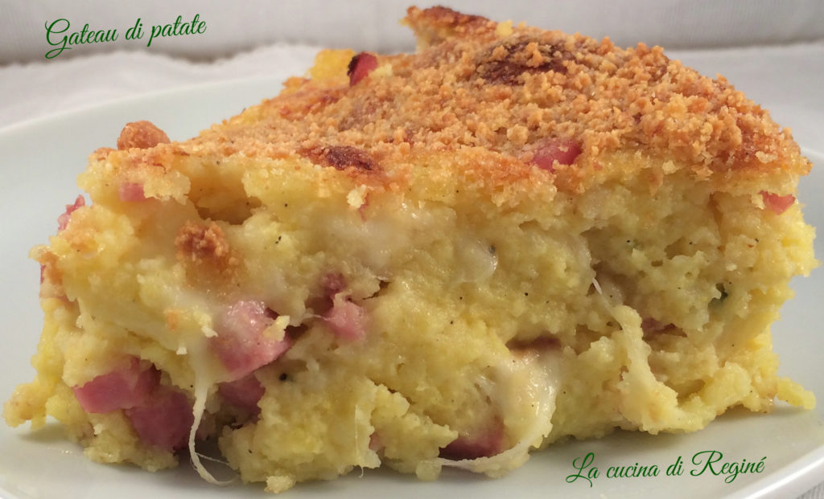
Doses and ingredients
Yellow pasta potatoes 500 g
Fiorglatte 100 g
Neapolitan salad 50 g
cooked ham in a thick slice 50 g
Parmesan Reggiano DOP (24 months)
2 tablespoons eggs
2 extra virgin olive oil q.b.
Black pepper Q.B. Salt up q.b.

